Slide 1
NMR Spectroscopy (Nuclear Magnetic Resonance)
By
Aparna Patil Kose
Lecturer
Dept of Bioinformatics

Slide 2
Introduction
Nuclear magnetic resonance (NMR) spectroscopy is the study of molecules by recording the interaction of radiofrequency (Rf) electromagnetic radiations with the nuclei of molecules placed in a strong magnetic field.
It relies on the phenomenon of nuclear magnetic resonance and provides detailed information about the structure, dynamics, reaction state, and chemical environment of molecules.

Slide 3
Basis of NMR Spectroscopy
NMR was first detected experimentally at the end of 1945, nearly concurrently with the work groups Felix Bloch, Stanford University and Edward Purcell, Harvard University.
The first NMR spectra was first published in the same issue of the Physical Review in January 1946. Bloch and Purcell were jointly awarded the 1952 Nobel Prize in Physics for their research of Nuclear Magnetic Resonance Spectroscopy.
NMR spectroscopy is a crucial analytical tool for organic chemists.
The research in the organic lab has been significantly improved with the aid of the NMR.
Not only can it provide information on the structure of the molecule, it can also determine the content and purity of the sample.
Proton (1H) NMR is one of the most widely used NMR methods by organic chemists.
The protons present in the molecule will behave differently depending on the surrounding chemical environment, making it possible to elucidate their structure.

Slide 4
Principle of NMR spectroscopy
Many nuclei have spin, and all nuclei are electrically charged, according to the NMR principle.
An energy transfer from the base energy to a higher energy level is achievable when an external magnetic field is supplied.
All nuclei are electrically charged and many have spin.
Transfer of energy is possible from base energy to higher energy levels when an external magnetic field is applied.
The transfer of energy occurs at a wavelength that coincides with the radio frequency.
Also, energy is emitted at the same frequency when the spin comes back to its base level.
Therefore, by measuring the signal which matches this transfer the processing of the NMR spectrum for the concerned nucleus is yield.

Slide 5
NMR Spectroscopy Working
Place the sample in a magnetic field.
Excite the nuclei sample into nuclear magnetic resonance with the help of radio waves to produce NMR signals.
These NMR signals are detected with sensitive radio receivers.
The resonance frequency of an atom in a molecule is changed by the intramolecular magnetic field surrounding it.
This gives details of a molecule’s individual functional groups and its electronic structure.
Nuclear magnetic resonance spectroscopy is a conclusive method of identifying monomolecular organic compounds.
This method provides details of the reaction state, structure, chemical environment and dynamics of a molecule.

Slide 6
NMR Spectroscopy Instrumentation
This instrument consists of nine major parts. They are discussed below:
Sample holder – It is a glass tube which is 8.5 cm long and 0.3 cm in diameter.
Magnetic coils – Magnetic coil generates magnetic field whenever current flows through it
Permanent magnet – It helps in providing a homogenous magnetic field at 60 – 100 MHZ
Sweep generator – Modifies the strength of the magnetic field which is already applied.
Radiofrequency transmitter – It produces a powerful but short pulse of the radio waves.
Radiofrequency – It helps in detecting receiver radio frequencies.
RF detector – It helps in determining unabsorbed radio frequencies.
Recorder – It records the NMR signals which are received by the RF detector.
Readout system – A computer that records the data.

Slide 7
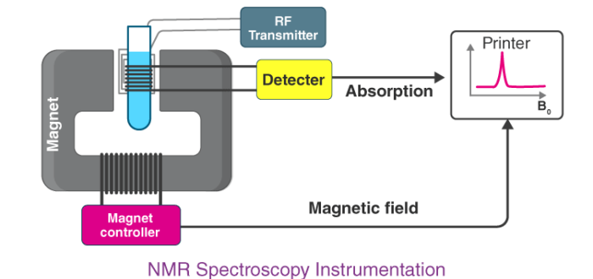

Slide 8
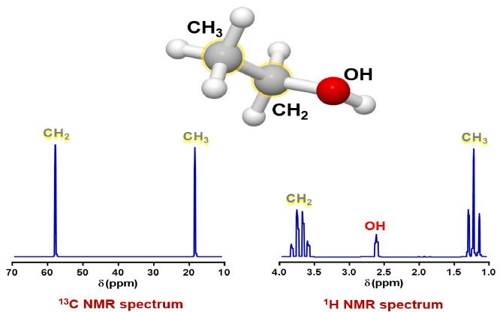

Slide 9
Applications of NMR spectroscopy
1. Structural elucidation: Most organic compounds have hydrogen in them. NMR helps to identify the number of hydrogen atoms, their types, position and other characters. Thus it helps to understand the structure of a compound.
2. Quantitative assay of components: A component or more can be estimated without separation. Even the percentage of hydrogen in a compound, the chain length of polymers like polythene, moisture content, etc. can be analyzed.
3. Identification of properties of molecules like the isomerism, hydrogen bonding, tautomerism, etc. can be determined by using NMR spectroscopy

